Slide 1
BUSINESS RECOMMENDATION SYSTEM ANALYSIS by PENIEL TENKORAMAH TWUM

Slide 2
INTRODUCTION
This project focuses on analyzing real-world e-commerce interaction data to improve recommendation systems and detect abnormal browsing behavior.
This project follows the CRISP-DM framework to ensure a structured approach.

Slide 3
KEY OBJECTIVES
2
Predict item properties (such as price range, product category) for products added to cart, using patterns from the same user's prior view events.
Detect abnormal users whose browsing patterns significantly deviate from normal behavior, in order to:
- Reduce noise and bias in the recommendation system.
- Improve the accuracy of split testing and overall analytics.

Slide 4
BUSINESS QUESTIONS
3
1. What proportion of customer interactions are views, additions to cart, or purchases?
2. Do customer interactions show seasonal trends?
3. Which products generate the most interest from customers?
4. Has product availability improved or worsened over time, and could this be impacting visits?
5. Which product categories attract the most attention from customers?
6. What percentage of views convert into purchases, and which events lose the most customers?
7. Using customer behaviour and interaction pattern , how can we recommend interest based properties and detect anamolies ?

Slide 5
DATA OVERVIEW
4
DATA SHAPE
(2,755,607 rows, 9 columns)
TIMEFRAME
May 2015 – SEPTEMBER 2015
TARGET VARIABLE:
EVENT=“TRANSACTION”

Slide 6
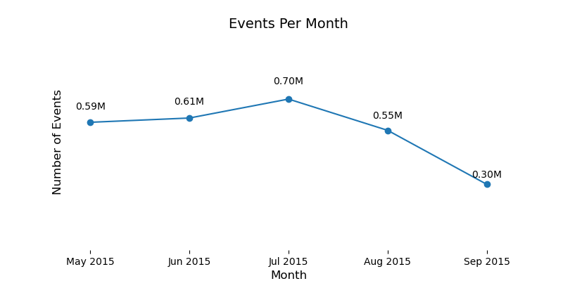
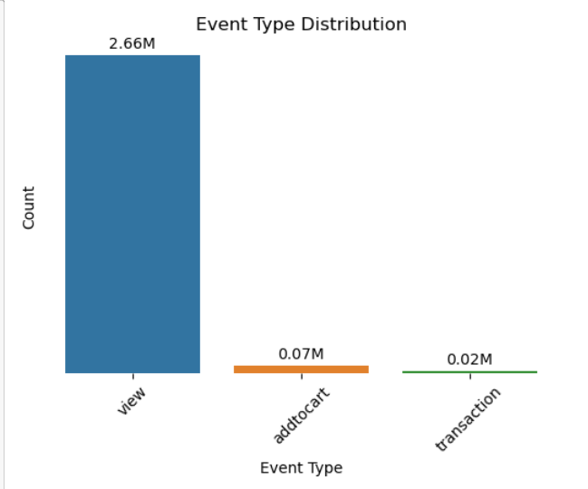
EVENT DISTRIBUTION ANALYSIS
Reveal seasonality and temporal spikes in activity especially in July.
The relative frequency of different events reveals add to cart and transaction levels are relatively low.

Slide 7
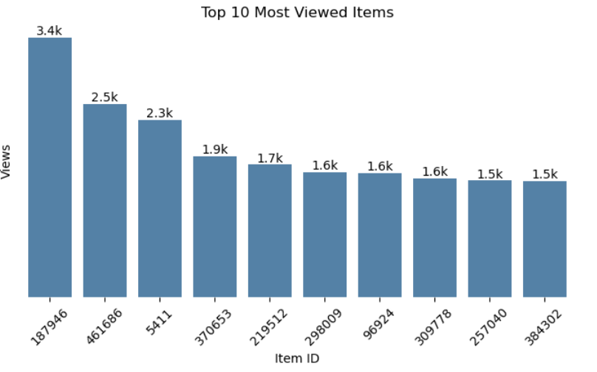
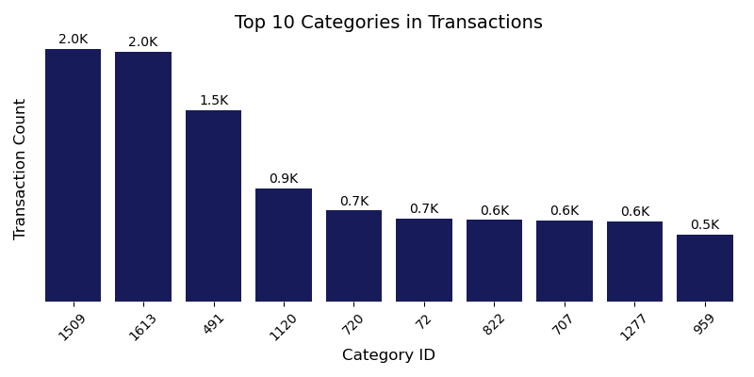
ITEM & CATEGORY POPULARITY
Identifies where user attention is concentrated for the items of interest while the categories in which most users make purchase from is identified.

Slide 8
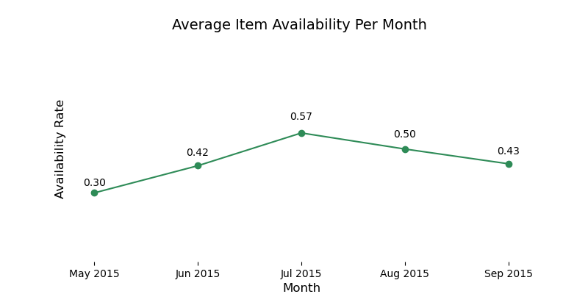
AVAILABILITY TREND
A trend of availability rate reviews that similar to events, availability rate of items is high in July which means that most restock happens around this period.

Slide 9
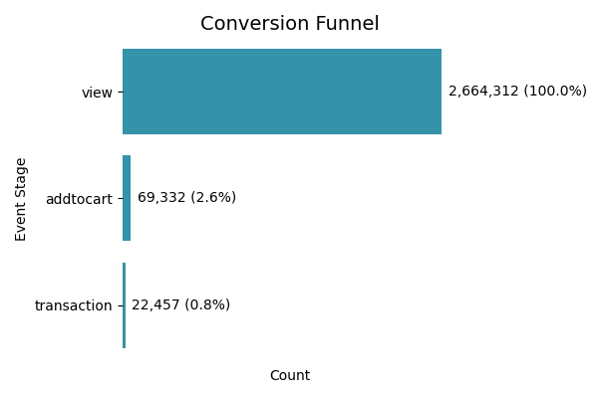
SALE CONVERSION
Less than 1% of visits and interactions actually lead to purchases which could be because most of the visitors may likely not be compelled by items enlisted.

Slide 10
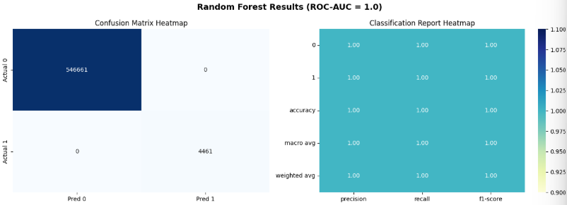
MODEL BUILDING SECTION
Random Forest Classifier - Predict whether a user will interact with an item (view/addtocart/transactions) given features like user history, item properties, and context.
Remark:
With a perfect score of 1 after applying SMOTE, this seems to be a case of overfitting as the model might be memorizing instead of generalizing.
This requires cross-validation and testing on truly unseen data.

Slide 11
2. Content-Based Filtering (CBF)
Uses item features (e.g., category, availability) and cosine similarity to recommend similar items.
Evaluation Score :
Precision@5 ≈ 0.0012
Recall@5 ≈ 0.0050
NDCG@5 ≈ 0.0034(Improves slightly as K increases)
Remark: Personalized to user history, but limited if item features are sparse or too simple.

Slide 12
3. Matrix Factorization using implicit - Recommends the most popular items in the training set, captures hidden general preferences.
Evaluation Score:
Precision@K: 0.0002
Recall@K: 0.0005
NDCG@K: 0.00023
Remark:
The model struggled to capture meaningful user–item interactions, likely due to sparsity of interactions and the dataset’s size/structure.
Performance is significantly lower compared to simpler baselines (e.g., Popularity or Random Forest classifiers).

Slide 13
4. Anomaly Detection (Isolation Forest) - Applied on visitor interaction statistics (e.g., average interaction, unique items/categories) to detect unusual user behavior.
- Used identifying bots, fraudulent accounts, or extreme activity patterns.
Evaluation Score:
Normal users (label = 1): 1,393,512
Anomalous users (label = -1): 14,049
Remark :
14K anomalous users (1% of total) detected with extreme interaction patterns. Their removal or special treatment can improve recommender precision.”

Slide 14
* Limitations & Future Improvements
Model | Limitations | Future Improvements
Random Forest Classifier (RFC) | Achieves perfect scores but likely overfits due to severe class imbalance. | Include cross-validation and testing on truly unseen data.
Matrix Factorization (ALS – Implicit) | Extreme sparsity (2Million interactions, many one-off users). Struggles with cold start users/items. | Tune hyperparameters (factors, regularization). Use neural matrix factorization or graph embeddings for richer latent factors.
Content-Based Filtering (CBF) | Limited personalization if features are sparse or low-quality. | Enrich item features (descriptions, text embeddings, images). Combine with collaborative signals (Hybrid).
Anomaly Detection (Isolation Forest) | Flags anomalies but not directly tied to recommendations. May incorrectly classify power users as anomalies. | Integrate anomaly scores into recommendation pipeline (filter bots, re-rank users).

Slide 15
CONCLUSION
The project demonstrate the trade-offs between accuracy, personalization, and robustness in recommender systems. While CBF and Matrix Factorization focus on relevance, RFC emphasizes classification accuracy, and anomaly detection adds a layer of user quality control.

Slide 16
Thank you
Peniel Tenkoramah Twum
+233-54-120-7295
Penieltwum42@gmail.com
github.com/Peniel-T

